Slide 1
Divisive and Agglomerative Clustering
Chathura Rajapakse

Slide 2
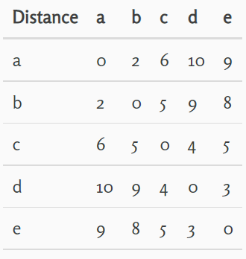
Divisive Clustering
Single cluster initially – then separate items based on distance
https://chih-ling-hsu.github.io/2017/09/01/Divisive-Clustering#:~:text=Divisive%20Clustering%20Example%20Who%20hates%20other%20members%20the,c%20to%20others%3A%20m%20e%20a%20n%20

Slide 3
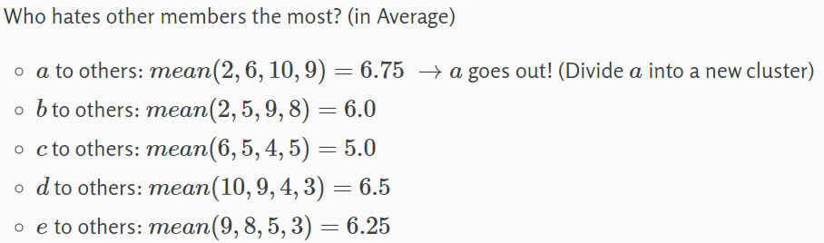
Separating the first item
https://chih-ling-hsu.github.io/2017/09/01/Divisive-Clustering#:~:text=Divisive%20Clustering%20Example%20Who%20hates%20other%20members%20the,c%20to%20others%3A%20m%20e%20a%20n%20

Slide 4
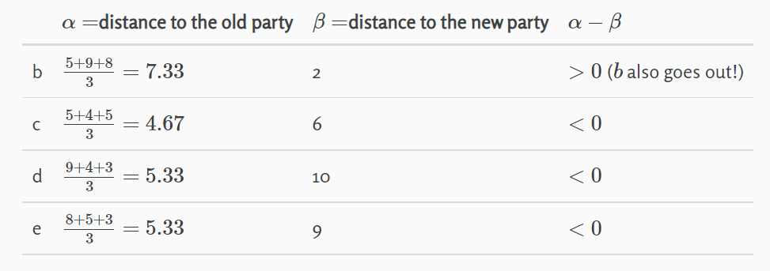

Who else joins the new cluster
https://chih-ling-hsu.github.io/2017/09/01/Divisive-Clustering#:~:text=Divisive%20Clustering%20Example%20Who%20hates%20other%20members%20the,c%20to%20others%3A%20m%20e%20a%20n%20

Slide 5
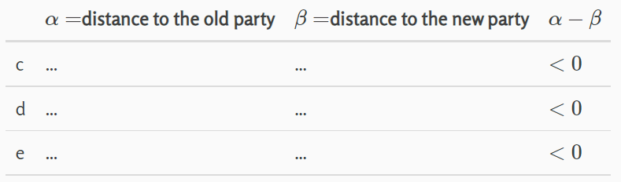
Is there anyone else left?
Until no one to join the new cluster, the process continues
https://chih-ling-hsu.github.io/2017/09/01/Divisive-Clustering#:~:text=Divisive%20Clustering%20Example%20Who%20hates%20other%20members%20the,c%20to%20others%3A%20m%20e%20a%20n%20

Slide 6
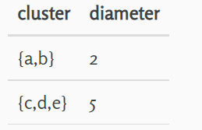
Which cluster to split next?
Two options:
Choose the one with highest number of items
Choose the one with highest diameter
The process continues until every cluster has only one item
https://chih-ling-hsu.github.io/2017/09/01/Divisive-Clustering#:~:text=Divisive%20Clustering%20Example%20Who%20hates%20other%20members%20the,c%20to%20others%3A%20m%20e%20a%20n%20

Slide 7
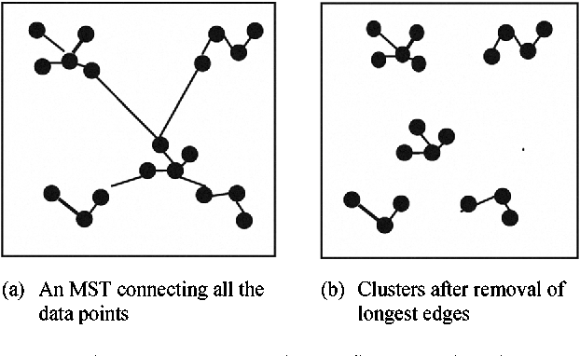
Minimum Spanning Tree Clustering
Start with a single point
In each successive step, attach a point to an existing member of the tree based on minimum distance formula
Create the tree with all points
Remove some number of longest distance arcs
https://chih-ling-hsu.github.io/2017/09/01/Divisive-Clustering#:~:text=Divisive%20Clustering%20Example%20Who%20hates%20other%20members%20the,c%20to%20others%3A%20m%20e%20a%20n%20

Slide 8
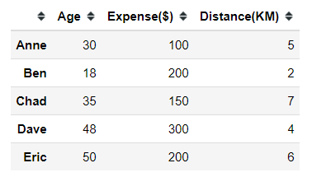
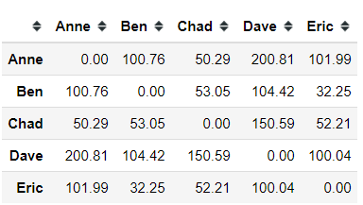
Agglomerative clustering
Starts with clusters with a single point – every point is a cluster
Add the two points with minimum distance
Recreate the proximity matrix
Repeat the process until it ends up with a single cluster
https://towardsdatascience.com/breaking-down-the-agglomerative-clustering-process-1c367f74c7c2

Slide 9
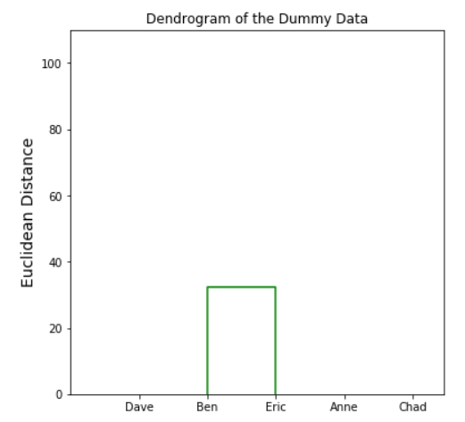
First agglomeration

Slide 10
Exercise:
Cluster the given dataset and observe
Reading: https://www.analyticsvidhya.com/blog/2019/05/beginners-guide-hierarchical-clustering/

